Slide 1
(Very short) Introduction to HL7 FHIR
Jan 2013
Grahame Grieve, Health Intersections
Ewout Kramer, Furore
Lloyd McKenzie, Gordon Point Informatics
Jean Duteau, Duteau Design Incorporated

Slide 2
ast
(to design & implement)
ealthcare
nteroperability
esources

Slide 3
What is FHIR?
Fast Healthcare Interoperability Resources
Pronounced “FIRE”
As significant as change from v2 to v3
Won’t be marketed as “v4” though
New artifacts
New methodology
New tools
New publishing approach
Still built on RIM, vocab & datatypes, but more hidden

Slide 4
Fhir SO FAR

Slide 5
Fresh Look
January 2011, the HL7 Board initiated a project called “Fresh Look”
“what would we do if we were to revisit the healthcare interoperability space from scratch?”
Sept. 2011, Grahame Grieve discussed some of the challenges (and successes) of HL7 v3 on his blog
Sept. 2011 WGM, First “preview” draft of FHIR, met with a very positive response

Slide 6
Transition to HL7
March 2012, HL7 Board of Directors agreed to a transfer of FHIR IP to HL7
Condition is that first normative edition of FHIR be made available for free to all implementers
Content now hosted on HL7 SVN under its own g-Forge project
Publication under HL7 URL:
http://www.hl7.org/fhir

Slide 7
HL7 Balloting and Connectathons
September 2012 WGM, First Connectathon was held. 10-15 attendees with four FHIR servers and four FHIR clients all interoperating with each other
September 2012 Ballot, Major balloting of FHIR with the infrastructure and a number of draft resources – Patient Administration, Pharmacy, Orders
September – January, Governance Structure setup with a Governance Board and a Management Group
January 2013 WGM, 2nd Connectathon was held. Ballot comments were worked on. Work is going on for a future DSTU ballot.

Slide 8
Why FHIR?

Slide 9
Poor market penetration
Possible causes:
Learning curve is steep
Development process is slow (try to cover all usecases)
Geared towards modeling, not implementation
Tools to develop, maintain & constrain are all custom

Slide 10
V3 is too hard?
V3 puts needs of the modeler before the needs of the implementer
Learning curve is too steep
Must significantly constrain to allow implementation
Tools to develop, maintain & constrain are all custom
Wire format is unstable

Slide 11
New Markets
If someone is building a new iOS healthcare app (and thousands are), what standard do we point them at?
If a vendor wants to provide a simple to use standards based API to cloud based health integration services, what standard should they extend?
If a government wants to implement a national EHR, who should they talk to?

Slide 12
What is FHIR?

Slide 13
Caveats !
FHIR is a work in progress
Specification has been looked at by many people and is currently being balloted but it is not final yet
FHIR continues to evolve
Much of what we tell you could change, at least somewhat, before it is stable

Slide 14
Who are we?
Grahame Grieve, Lloyd McKenzie, Ewout Kramer
Jean-Henri Duteau, Andy Stechishin, Woody Beeler, Gerald Beuchelt
Austin Kreisler, Bo Dagnall, Ron Parker, Klaus Veil, Rene Spronk, Lynn Laakso

Slide 15
FHIR premises
Design for the 80%, not 100%
Allow easy extension for the remaining 20% of elements
Focus publication on documenting what the implementer needs, not what the modelers thought or designers need to remember
Notes:
Only include data elements in the artifacts if 80% of all implementers of that artifact will use the data element
The 20%….which often make up 80% of current specs
Vocabulary approach to extension definition

Slide 16
FHIR Basics
Build around the concept of “resources”
Small, discrete concepts that can be maintained independently
Similar to the concept of CMETs, but there’s only *one* model per resource
Can be individually designed, documented, exchanged and interpreted
100-150 total for all of healthcare.
Notes:
All defined by HL7
Examples: Patient, Prescription, LabReport
REST:
Each resource has a unique URL
Resources are smallest units of transaction
HTTP based atomic transactions for CRUD Operations

Slide 17
FHIR Basics (cont’d)
Built-in extension mechanism
Extension is not a “dirty word” in FHIR
Full support for textual mark-up
Support for
REST,
Messaging,
Documents
Notes:
Wire format remains stable, even as extensions occur
With FHIR, all resources, as well as all resource attributes have a free-text expression, an encoded expression or both
Mark up is xhtml directly

Slide 18
Resource representations
Each resource is published with several views covering different aspects
UML diagram
Simple pseudo-XML syntax
Vocabulary bindings
Notes
Search Criteria
Data dictionary
Example instance
Schema

Slide 19
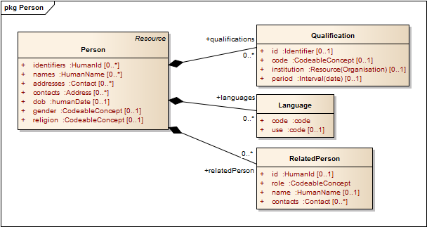
Example - Person

Slide 20
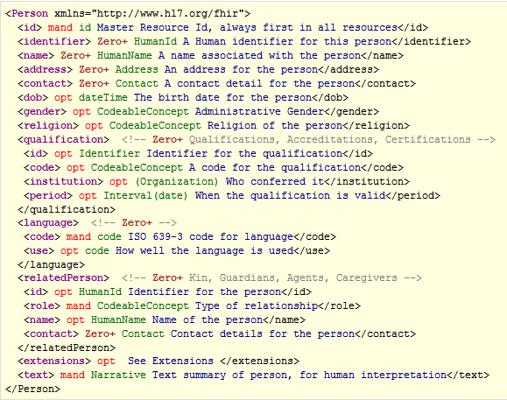
Example - Person

Slide 21
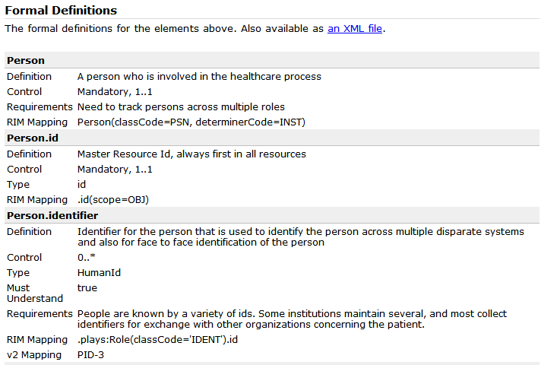
Example - Person

Slide 22
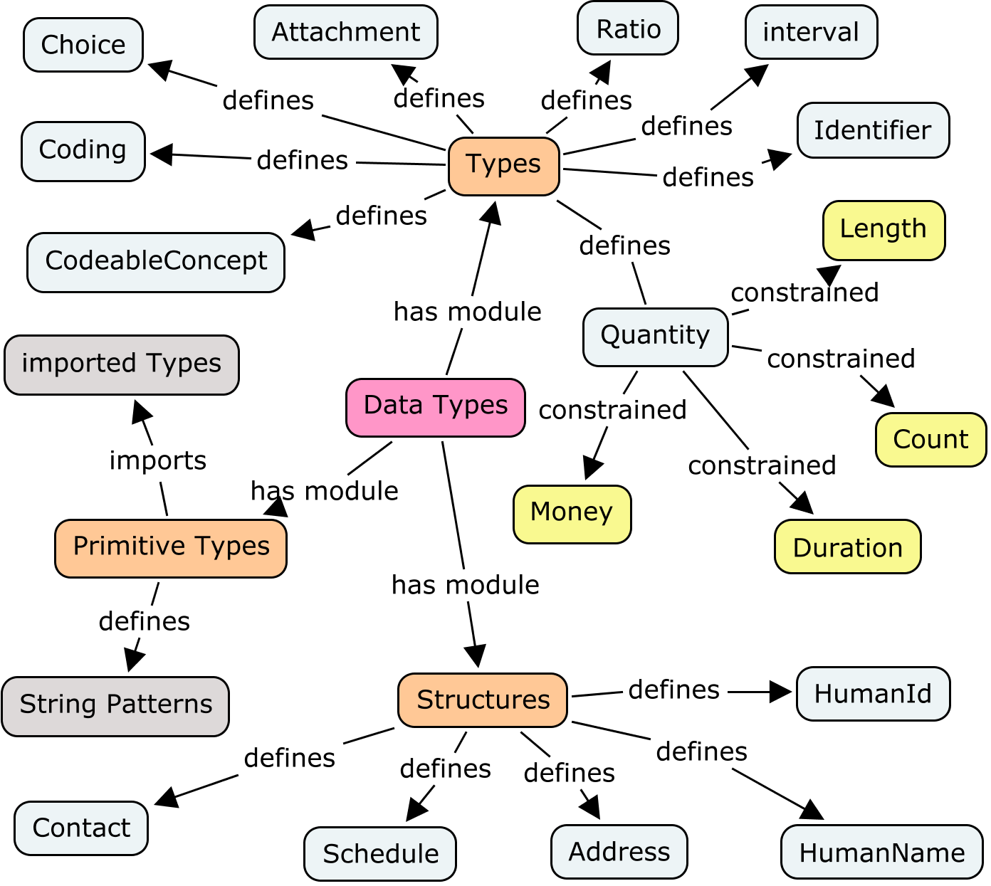
New datatypes model

Slide 23
Profiles
These resources are used in many different contexts in healthcare.
Profiles explain how a set of resources is used in a particular context:
Describe restrictions
Define the extensions
Describe terminology in that context
Layered: International, National, Regional, Organization, Department

Slide 24
Messages
Collection of resources sent as a result of some real-world event intended to accomplish a particular purpose
Event Codes & Definitions, like HL7 v2
Some message profiles will be defined by HL7, others by projects or implementers
Includes a “Message” resource, similar in purpose to Message wrapper and MSH segment
May have associated behavior
Can be conveyed via MLLP, SOAP or other means

Slide 25
Documents
Collection of resources grouped for persistence and attestation
Some document profiles will be defined by HL7, others by projects or implementers
Includes a “Document” resource, similar in purpose to CDA header

Slide 26
Tools
Generation tool built in Java. Anyone can build the publication at will
Source files maintained as xml spreadsheets
Easy Editing
Easy source control & Easy merging
Easy importing into whatever
Need registry tool for profiles, extensions

Slide 27
Publishing
Current version at http://www.hl7.org/fhir
Implies a new & different ballot publication process
FHIR is balloted as a single spec like v2
Instance example mandatory
Publication automatically generated from source files – by anyone
Schemas
HTML
Validation of instance example
reference implementations: Java, C#, others

Slide 28
What next?

Slide 29
Working with Workgroups
Who owns what resource?
When do we create a new resource?
Need to avoid overlap
Existing problem becomes more important
What fits in the 80%?
How much time do we give to FHIR vs. traditional v3?
When faced with a use-case, do we use documents, messages, services or REST?
Can do all of the above, but multiple solutions could have interoperability consequences

Slide 30
Follow-up
Review content on the FHIR site
http://www.hl7.org/fhir
Provide feedback on the wiki
Mailinglist:
fhir@lists.hl7.org

Slide 31
Contacts
FHIR Mailing list: fhir@lists.hl7.org
Grahame: grahame@healthintersections.com.au
Ewout: e.kramer@furore.com
Lloyd: lloyd@lmckenzie.com

Slide 32
Questions & Answers

Slide 33
Q&A
What’s the timeline?
DSTU first ballot of initial set of resources this fall
In theory could be done DSTU of implementable chunk of FHIR in 2 years
In practice, dependent on work of committees

